Slide 1
Comprehensive VHDL Hamdi Abdelbagi Phone: (937) 830-7761 Email: abdelbagih1@udayton.edu

Slide 2
TEXTIO
Aim
To understand the use of TEXTIO in reading and writing text files
Topics covered
TEXTIO
READ and WRITE
TEXTOIO FOR STIMULUS AND OUTPUTS
STD_LOGIC_TEXTIO

Slide 3
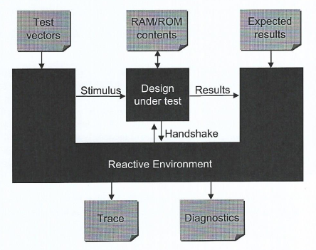
TEXTIO and Testbenches

Slide 4
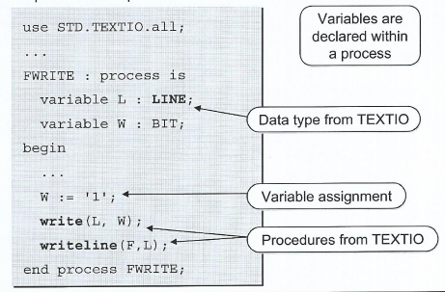
Reading and Writing Text Files
Text files are used because they are portable
Standard reading and writing procedures are provided in STD.TEXTIO
Requires variable parameters

Slide 5
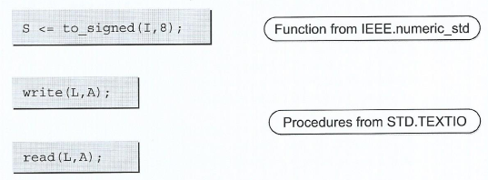
Introduction to Subprograms
Subprogram may be either procedures or functions
Procedure may return values via their arguments
Functions return a single result value as part of an expression
Subprogram may be overloaded

Slide 6
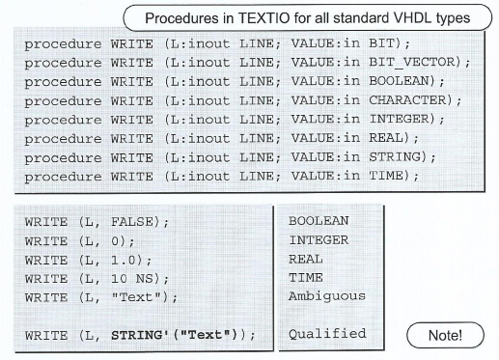
Overloaded Write Procedures

Slide 7
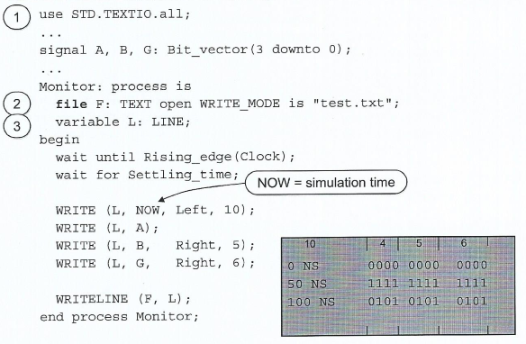
TEXTIO Output

Slide 8
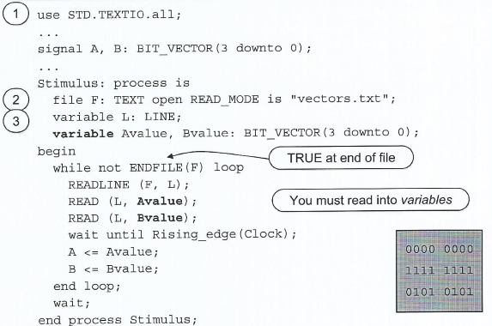
TEXTIO Input

Slide 9
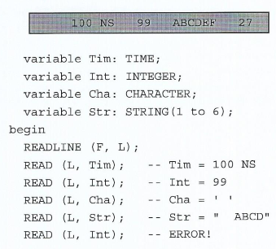
Procedure READ
READ skips spaces, except for types Characters and String

Slide 10
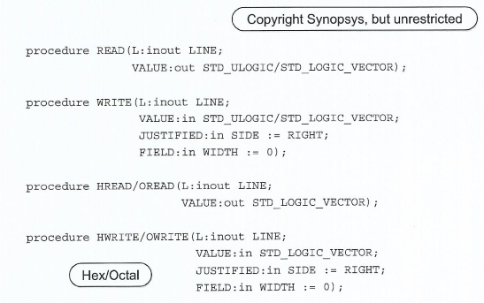
Package STD_LOGIC_TEXTIO

Slide 11
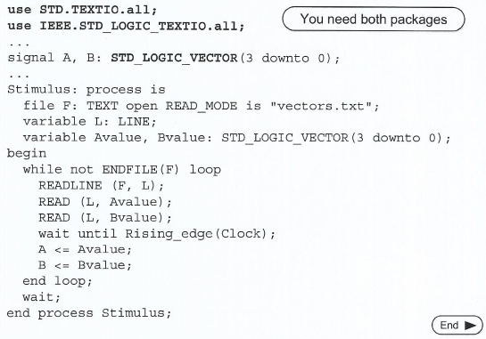
Using STD_LOGIC_TEXTIO

Slide 12
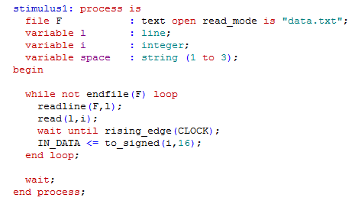
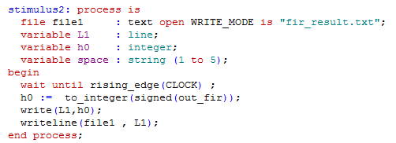
Example

Slide 13
More About Types
Aim
To understand more about types, variable, and loops
Topics covered
Variables
Loops
Array and integer subtypes
Std_logic and resolution
Aggregates

Slide 14
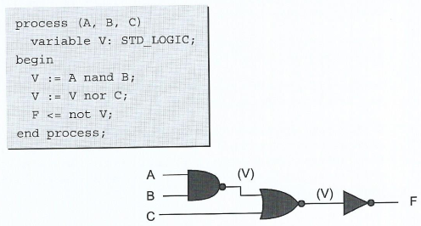
Variables
Variables can only be declared and use inside a process
Variable assignment occurs immediately

Slide 15
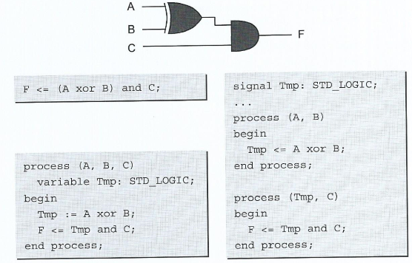
Variables versus Signals

Slide 16
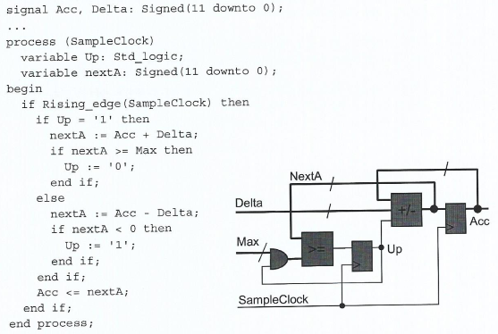
Synthesis of variables

Slide 17
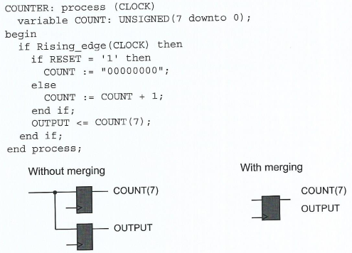
flip-Flop Merging

Slide 18
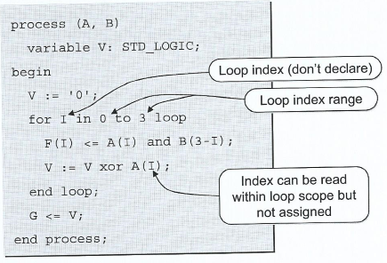
For Loops
Sequential construct that allows behavior be described as an iterative algorithm

Slide 19
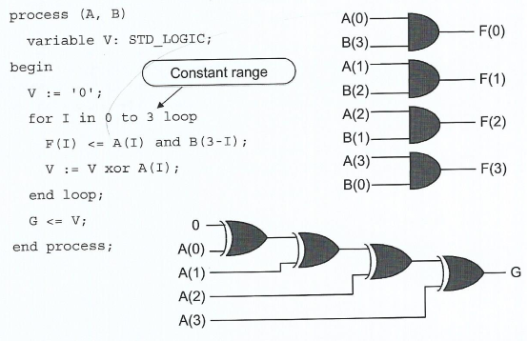
Synthesis of For Loops

Slide 20
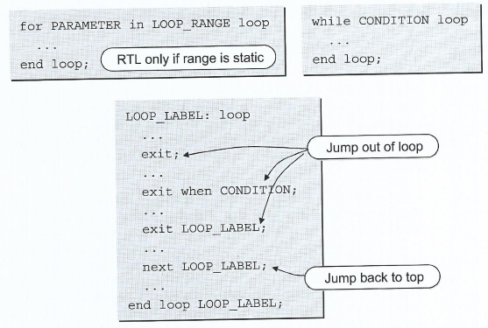
Other Loops Statements

Slide 21
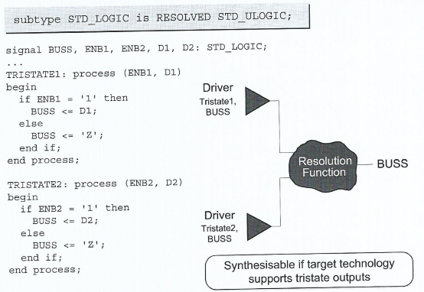
Tristate Drivers

Slide 22
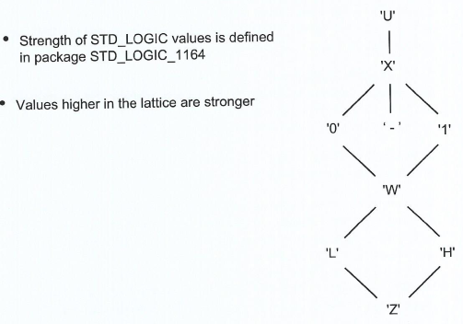
STD_LOGIC Bus Resolution

Slide 23
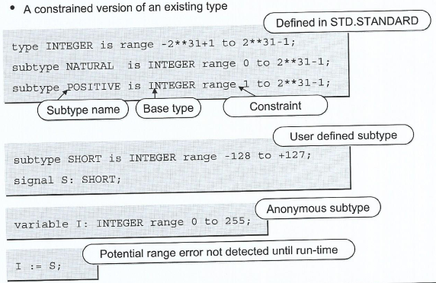
Subtypes

Slide 24
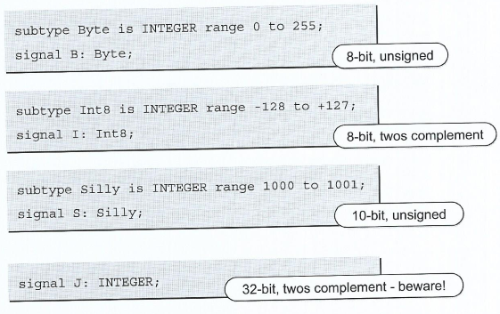
Synthesis of Integer Subtypes

Slide 25
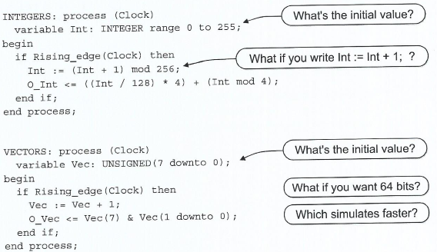
Integer versus Array

Slide 26
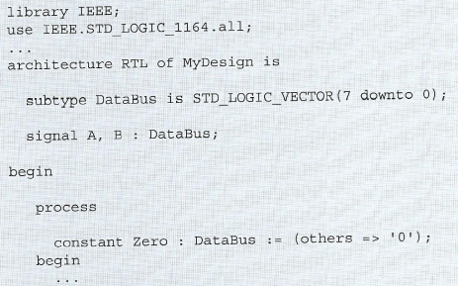
Array Subtypes

Slide 27
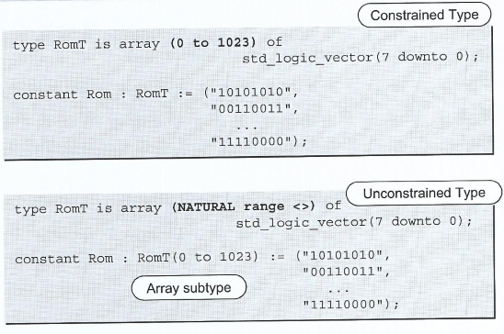
User-defined Array Types and Subtypes

Slide 28
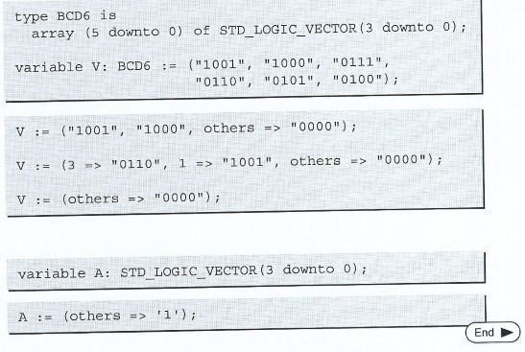
Aggregates

